Slide 1
APA Formatting and Style Guide
Notes:
Welcome to “APA Formatting and Style Guide”. This Power Point Presentation is designed to introduce your students to the basics of APA Formatting and Style Guide. You might want to supplement the presentation with more detailed information posted on Purdue OWL http://owl.english.purdue.edu/owl/resource/560/01/

Slide 2
What is APA?
The American Psychological Association (APA) citation style is the most commonly used format for manuscripts in the social sciences.
APA regulates:
Stylistics
In-text citations
References
Notes:
Publication Manual of the American Psychological Association, 6th ed., contains detailed guidelines to formatting a paper in the APA style. APA style is most commonly used for formatting papers in the Social Sciences—business, economics, psychology, sociology, nursing, etc. Updates to APA are posted on the APA website www.apastyle.org. You may also reference the Purdue OWL: http://owl.english.purdue.edu/.
APA format provides writers with a format for cross-referencing their sources--from their parenthetical references to their reference page. This cross-referencing system allows readers to locate the publication information of source material. This is of great value for researchers who may want to locate your sources for their own research projects. The proper use of APA style also shows the credibility of writers; such writers show accountability to their source material. Most importantly, use of APA style can protect writers from plagiarism--the purposeful or accidental use of source material by other writers without giving appropriate credit.

Slide 3
APA Style: Language
Language in an APA paper is:
clear: be specific in descriptions and explanations
concise: condense information when you can
plain: use simple, descriptive adjectives and minimize figurative language
Notes:
This slide explains the APA requirements to language of an APA paper.
Clarity and conciseness are the major concern when reporting research in APA . It is not easy to balance clarity (which requires providing clarification) and conciseness (which requires packing information). To achieve clarity, a writer should avoid vague wording and be specific in descriptions and explanations. To achieve conciseness, a writer should condense information. Because APA format is widely used in science-related papers, the language of APA format is plain and simple. A writer should avoid using metaphors and minimize the use of figurative language, which is typical for creative writing.
This slide can be supplemented by the relevant sections from OWL
http://owl.english.purdue.edu/owl/resource/560/15/
http://owl.english.purdue.edu/owl/resource/560/14/
and “Conciseness in academic writing” handout http://owl.english.purdue.edu/owl/resource/572/01/

Slide 4
General Format

Slide 5
General Format
Your essay should:
be typed and double-spaced
be printed on standard-sized paper (8.5”x11”)
use 1” margins on all sides
use 12 pt. Times New Roman or a similar font
include a page header (title) in the upper left-hand of every page and a page number in the upper right-hand side of every page
Note: If you are writing a manuscript draft, APA suggests using two spaces between sentences to aid readability (see pp. 87-88 in the APA manual).
Notes:
This slide presents the general format of an APA formatted paper: An essay should be typed and double-spaced on the standard-sized paper (8.5”x11”) with 1” margins on all sides. Times New Roman or similar font in 10-12 pt. size should be used. The document should include a page header indicating a short title of the essay and a page number in the upper right-hand of every page (including the title page).

Slide 6
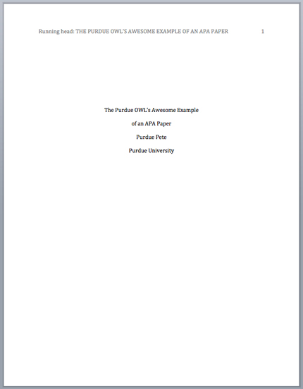
Title Page
Page header:
(use Insert Page Header)
title flush left + page number flush right.
Title:
(in the upper half of the page, centered)
name (no title or degree) + affiliation (university, etc.)
Notes:
This slide visually presents APA format of a title page, which consists of four major sections: a page header, a running head for publication, and a title.
To create a page header, use “Insert Page Header” function of MSO Word. Choose “Insert Page Number” in the upper right-hand side and type two-three words of the title before page number. Separate the abbreviated title from the page number with five spaces.
To create a running head for publication, type Running Head: ABBREVIATED TITLE on the first line, flush-left, maximum 60 characters long. Note: Although a running head section is required for manuscripts submitted for publication, it is an optional sections for students’ papers.
To create a title, type—in the upper half of the page, centered– a full title of the essay, writer’s name and affiliation (college or university) on subsequent lines. Note: the instructor might also require his/her name, course title, and date in addition to affiliation. Encourage students to consult the instructor regarding specific requirements to a title section.
This slide can be supplemented by the relevant section from OWL http://owl.english.purdue.edu/owl/resource/560/01/

Slide 7
Main Body (Text)
Number the first text page as page number 2
Type and center the title of the paper at the top of the page
Type the text double-spaced with all sections following each other without a break
Identify the sources you use in the paper in parenthetical in-text citations
Notes:
This slide provides the basic reminders about formatting the text:
Make sure that the first text page is page number 3 (page#1 is a title page, page #2 is an abstract page).
Start with typing the essay title centered, at the top of the page.
Type the text double-space with all sections following each other without a break. Do not use white space between paragraphs.
Create parenthetical in-text citations to identify the sources used in the paper.
Format tables and figures.
The following slides introduce APA formatting of references, in-text citations, and tables and figures.

Slide 8
References
Basics

Slide 9
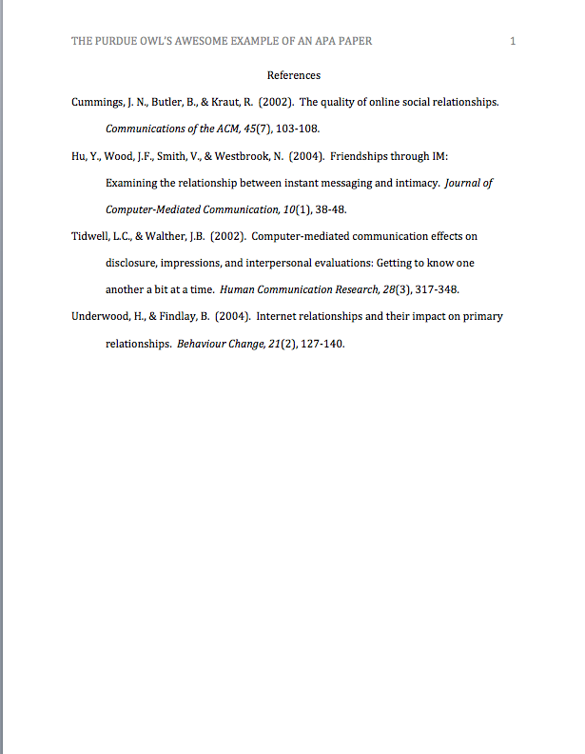
References Page
Center the title (References) at the top of the page. Do not bold it.
Double-space reference entries
Flush left the first line of the entry and indent subsequent lines
Order entries alphabetically by the author’s surnames
Example: http://flash1r.apa.org/apastyle/basics/data/resources/references-example.pdf
Notes:
This slide explains the format and purpose of a references page.
The facilitator may stress that each source referenced within the paper should also appear on the reference page, which appears at the end of the paper.
To create a references page,
center the heading—References—at the top of the page;
double-space reference entries;
flush left the first line of the entry and indent subsequent lines. To use “hanging” feature of “Indent and Space” tab, go to “Paragraph” →”Indentation” →choose “Hanging” in the ”Special” box.
Order entries alphabetically by the author’s surnames. If a source is anonymous, use its title as an author’s surname.
Note: Unlike MLA, APA is only interested in what they call “recoverable data”—that is, data which other people can find. For example, personal communications such as letters, memos, emails, interviews, and telephone conversations should not be included in the reference list since they are not recoverable by other researchers.
For specific information about entries in the reference list, go to http://owl.english.purdue.edu/owl/resource/560/05/.

Slide 10
References: Basics
Invert authors’ names (last name first followed by initials: “Smith, J.Q.”)
Alphabetize reference list entries the last name of the first author of each work
Capitalize only the first letter of the first word of a title and subtitle, the first word after a colon or a dash in the title, and proper nouns. Do not capitalize the first letter of the second word in a hyphenated compound word.
Notes:
This slide provides basic rules related to creating references entries.

Slide 11
References: Basics
Capitalize all major words in journal titles
Italicize titles of longer works such as books and journals
Do not italicize, underline, or put quotes around
the titles of shorter works such as journal articles or essays in edited collections
Notes:
This slide provides basic rules related to creating references entries.

Slide 12
Making the References List
APA is a complex system of citation. When compiling the reference list, the strategy below might be useful:
Identify the type of source: Is it a book? A journal article? A webpage?
Find a sample of citing this type of source in the textbook or in the OWL APA Guide: http://owl.english.purdue.edu/owl/resource/560/01/
“Mirror” the sample
Make sure that the entries are listed in the alphabetical order and the subsequent lines are indented (Recall References: Basics)
Notes:
APA is a complex system of citation, which is time-consuming to learn and difficult to keep in mind. To help students handle the requirements of APA format, this slide introduces a strategy of surviving APA.
The facilitator should stress the importance of correct identification of a type of source: e.g., Is it an article from a newspaper or from a scholarly journal? Hard copy or electronic version?
When the source type is identified correctly, it’s fairly easy to find a sample of a similar reference in the APA chapter of a composition book or in an on-line APA resource. The APA guide on the OWL website is particularly easy to browse since its links are organized by types of sources—scroll down to the box of links http://owl.english.purdue.edu/owl/resource/560/01/
After a sample is found, all it takes is to mirror it precisely and arrange entries in the alphabetical order.
Note: Many electronic library databases, e.g. Proquest, have citation feature. The useful strategy is to save and import into a references list citation entries (make sure you choose APA format) while doing literature search. You can always delete later reference entries of the sources you’re not going to use in the paper.

Slide 13
In-text citations
The Basics

Slide 14
In-text Citations: Basics
In-text citations help readers locate the cited source in the References section of the paper.
Whenever you use a source, provide in parenthesis:
the author’s name and the date of publication
for quotations and close paraphrases, provide the author’s name, date of publication, and a page number
Notes:
This slide explains the basics of in-text citations.
In-text citations help establish credibility of the writer, show respect to someone else’s intellectual property (and consequently, avoid plagiarism). More practically, in-text citations help readers locate the cited source in the references page. Thus, keep the in-text citation brief and make sure that the information provided in the body of the paper should be just enough so that a reader could easily cross-reference the citation with its matching entry on the reference page; i.e., the body of the paper and the in-text citation together contains the author’s name and the year of publication. To avoid plagiarism, also provide a page number (in p.3 / pp.3-5 format) for close paraphrases and quotations.

Slide 15
In-text Citations: Formatting Quotations
When quoting, introduce the quotation with a signal phrase. Make sure to include the author’s name, the year of publication, the page number, but keep the citation brief—do not repeat the information.
Caruth (1996) has stated that a traumatic response
frequently entails a “delayed, uncontrolled repetitive appearance of hallucinations and other intrusive phenomena” (p.11).
A traumatic response frequently entails a “delayed, uncontrolled repetitive appearance of hallucinations and other intrusive phenomena” (Caruth, 1996, p.11).
Notes:
This slide provides explanation and examples of in-text citations with quotations.

Slide 16
In-text Citations: Formatting a Summary or Paraphrase
Provide the author’s last name and the year of
publication in parenthesis after a summary or a paraphrase.
Though feminist studies focus solely on women's
experiences, they err by collectively perpetuating the masculine-centered impressions (Fussell, 1975).
Notes:
The following three slides provide instructions and examples of in-text citations with summary/ paraphrase.
The facilitator should emphasize the importance of developing the skills of critical reading (which enables finding main claims in the text), summarizing, and paraphrasing. When paraphrasing or summarizing, the major concern should be fair and accurate representation of the ideas in the source.
This slide can be supplemented by the “Quoting, Paraphrasing, and Summarizing” section from OWL
http://owl.english.purdue.edu/owl/resource/563/01/

Slide 17
In-text Citations: Formatting a Summary or Paraphrase
When including the quotation in a summary/paraphrase, also provide a page number in parenthesis after the quotation:
According to feminist researchers Raitt and Tate
(1997), “It is no longer true to claim that women's
responses to the war have been ignored” (p. 2).
Notes:
This slide continues explaining formatting in-text citations with summary/ paraphrase.

Slide 18
In-text Citations: Signal Words
Introduce quotations with signal phrases, e.g.
According to X. (2008), “….” (p. 3).
X. (2008) argued that “……” (p. 3).
Use such signal verbs as:
acknowledged, contended, maintained,
responded, reported, argued, concluded, etc.
Notes:
Acquiring a rich repertoire of signal words and phrases is the key to success in representing others’ ideas in academic writing. This slide provides a few examples of those and reminds that APA requires to use the past or present perfect tense of verbs in signal phrases.
The facilitator might want to point to the chapter in the composition book that introduces and practices signal words.

Slide 19
In-text Citations: Two or More Works
When the parenthetical citation includes two or
more works, order them in the same way they appear in the reference list—the author’s name, the year of publication—separated by a
semi-colon.
(Kachru, 2005; Smith, 2008)
Notes:
This slide explains and exemplifies the specific cases of in-text citations. It might be supplemented with “Author/Authors” section from OWL http://owl.english.purdue.edu/owl/resource/560/03/

Slide 20
In-text Citations: A Work with Three to Five authors
When citing a work with three to five authors, identify all authors in the signal phrase or in parenthesis.
(Harklau, Siegal, & Losey, 1999)
In subsequent citations, only use the first author's last name followed by "et al." in the signal phrase or in parentheses.
(Harklau et al., 1993)
Notes:
This slide explains and exemplifies the specific cases of in-text citations. It might be supplemented with “Author/Authors” section from OWL http://owl.english.purdue.edu/owl/resource/560/03/

Slide 21
In-text Citations: A Work with Two Authors
When citing a work with two authors, use “and”
in between authors’ name in the signal phrase and “&” between their names in parenthesis.
According to feminist researchers Raitt and Tate
(1997), “It is no longer true to claim that women's
responses to the war have been ignored” (p. 2).
Some feminists researchers question that “women's
responses to the war have been ignored” (Raitt &
Tate, 1997, p. 2).
Notes:
This slide explains and exemplifies the specific cases of in-text citations. It might be supplemented with “Author/Authors” section from OWL http://owl.english.purdue.edu/owl/resource/560/03/

Slide 22
In-text Citations: A Work with Six and More Authors
When citing a work with six and more authors, identify the first author’s name followed by “et al.”
Smith et al. (2006) maintained that….
(Smith et al., 2006)
Notes:
This slide explains and exemplifies the specific cases of in-text citations. It might be supplemented with “Author/Authors” section from OWL http://owl.english.purdue.edu/owl/resource/560/03/

Slide 23
In-text Citations: A Work of Unknown Author
When citing a work of unknown author, use the source’s full title in the signal phrase and cite the first word of the title followed by the year of publication in parenthesis. Put titles of articles and chapters in quotation marks; italicize titles of books and reports.
According to “Indiana Joins Federal
Accountability System” (2008), …
Or,
(“Indiana,” 2008)
Notes:
This slide explains and exemplifies the specific cases of in-text citations. It might be supplemented with “Author/Authors” section from OWL http://owl.english.purdue.edu/owl/resource/560/03/

Slide 24
In-text Citations: Organization
When citing an organization, mention the organization the first time when you cite the source in the signal phrase or the parenthetical citation.
The data collected by the Food and Drug
Administration (2008) confirmed that…
If the organization has a well-known abbreviation, include the abbreviation in brackets the first time the source is cited and then use only the abbreviation in later citations.
Food and Drug Administration (FDA) confirmed … FDA’s experts tested…
Notes:
This slide explains and exemplifies the specific cases of in-text citations. It might be supplemented with “Author/Authors” section from OWL http://owl.english.purdue.edu/owl/resource/560/03/

Slide 25
In-text Citations: Electronic sources
When citing an electronic document, whenever possible, cite it in the author-date style. If electronic source lacks page numbers, locate and identify paragraph number/paragraph heading.
According to Smith (1997), ... (Animals section, para. 6).
Notes:
This slide explains and exemplifies the specific cases of in-text citations. It might be supplemented with “Author/Authors” section from OWL http://owl.english.purdue.edu/owl/resource/560/03/

Slide 26
The End
Notes:
Writer and Designer: Jennifer Liethen Kunka
Contributors: Muriel Harris, Karen Bishop, Bryan Kopp, Matthew Mooney, David Neyhart, and Andrew Kunka
Revising Author: Elizabeth Angeli, 2011; Elena Lawrick, 2008
Developed with resources courtesy of the Purdue University Writing Lab
Grant funding courtesy of the Multimedia Instructional Development Center at Purdue University
© Copyright Purdue University, 2000, 2006, 2007, 2008

